Slide 1
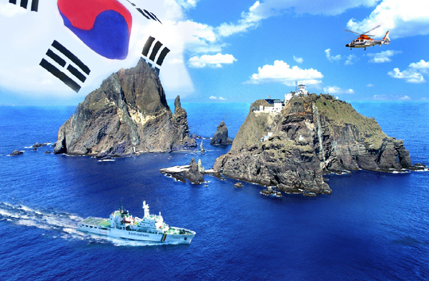
Abe’s Revisionist Policy toward Korea’s Dokdo
Prof. Edward Kwon, Ph.D.

Slide 2
Contents
I. Introduction
II. Political Background of Abe
III. Abe’s Revisionist Policy
IV. Abe’s Elaborate Policy toward Dokdo
V. Conclusion

Slide 3
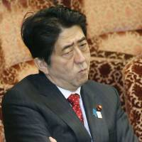
I. Introduction
Prime Minister, Shinzo Abe’s Revisionist Policy
has been distorted several historical facts related to Japanese’s brutal colonial rules
sex slaves, territorial ownership, compulsory manpower draft (wartime forced labor)..
Agreement on the Settlement of Problem concerning Property and Claims and the Economic Cooperation between the Republic of Korea and Japan// Hashima Coal Mine in Nagasaki Prefecture// Nippon Steel
Abe ruined diplomatic relationship with Republic of Korea to whitewash its shameful legacy of Japan’s imperialism.
Abe’s elaborated policy
tries to implant misguided belief of Japan’s territorial claim on Korea’s Dokdo

Slide 4
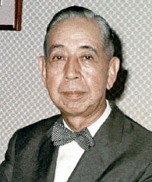
II. Political Background of Abe
Abe’s family background
His father, Shintaro Abe, occupied several minister positions during the 1970s and 1980s.
Abe’s role model, his grandfather, Nobusuke Kishi, was prime minister from 1956 to 1960.
built the State of Manchuria
sought to industrialize the country as one of the founding members of the MITI (Ministry of International Trade and Industry),
wished to revise the peace constitution
Following in the footsteps of his grandfather
Abe tried to transform the country into a normal state by amending Article 9 of the Japanese constitution

Slide 5
The Article 9 of the Constitution of Japan
Aspiring sincerely to an international peace based on justice and order, the Japanese people forever renounce war as a sovereign right of the nation and the threat or use of force as means of settling international disputes.
In order to accomplish the aim of the preceding paragraph, land, sea, and air forces, as well as other war potential, will never be maintained. The right of belligerency of the state will not be recognized.

Slide 6
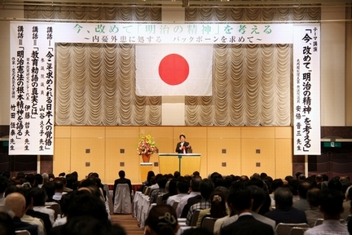
Abe was born in 1954 (postwar generation)
Member of Nippon Kaigi (right-wing revisionist org)
never experienced the disastrous WWII
most older Japanese regret the militarism inflicted torture on neighbor countries and caused the U.S. atomic bombing of Hiroshima and Nagasaki
Believed Japanese troops were never involved in the 1937 Nanjing massacre and were not directly engaged in forcing innocent women into sexual slavery during WWII

Slide 7
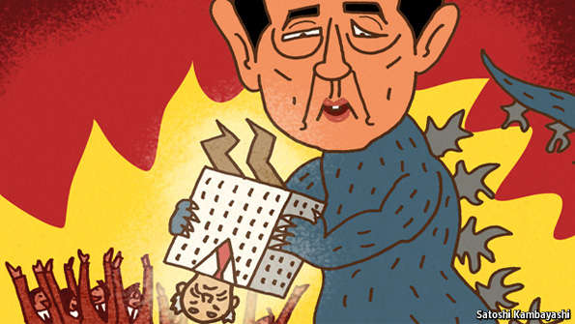
Operational Code of Abe
A leader’s beliefs about the nature of politics and political conflict
The operational code is a branch of study of the personalities of world political leaders
Viewpoint regarding the historical development, notion of correct strategy and tactics
Such belief system is influencing leader’s decision
important to understanding/analyzing how leaders will react to certain world events.

Slide 8
III. Abe’s Revisionist Policy
Abe has been pushing an ultra-nationalist policy agenda
Revisionist historical views sought to deny
The 1993 Kono Statement
The 1995 Murayama Statement
Went to the Yasukuni Shrine on Dec. 26, 2013
The remains of 14 Class-A war criminals were moved there
Japanese emperors Hirohito and Akihito had ended the visitation after 1987
Abe sent offering to Yasukuni shrine for war dead, Aug 15, 2019
Four Abe’s cabinet members visit Aug 15, 2020

Slide 9
Statement by the Chief Cabinet Secretary Yohei Kono on the result of the study on the issue of “comfort women” Aug 4, 93
The Government of Japan has been conducting a study on the issue of wartime "comfort women" since December 1991.
Japanese military was, directly or indirectly, involved in the establishment and management of the comfort stations and the transfer of comfort women.
they were recruited against their own will, through coaxing, coercion, etc., ….. They lived in misery at comfort stations under a coercive atmosphere.
The Government of Japan would like to take this opportunity once again to extend its sincere apologies and remorse to all those, irrespective of place of origin, who suffered immeasurable pain and incurable physical and psychological wounds as comfort women.
We hereby reiterate our firm determination never to repeat the same mistake by forever engraving such issues in our memories through the study and teaching of history.
https://www.mofa.go.jp/policy/women/fund/state9308.html

Slide 10
Statement by Prime Minister Tomiichi Murayama “On the occasion of the 50th anniversary of the war's end” Aug 15, 95
Our task is to convey to younger generations the horrors of war, so that we never repeat the errors in our history.
we should bear in mind that we must look into the past to learn from the lessons of history, and ensure that we do not stray from the path to the peace and prosperity of human society in the future.
During a certain period … Japan, following a mistaken national policy, advanced along the road to war… and, through its colonial rule and aggression, caused tremendous damage and suffering to the people of many countries, particularly to those of Asian nations.
In the hope that no such mistake be made in the future, I regard, in a spirit of humility, these irrefutable facts of history, and express here once again my feelings of deep remorse and state my heartfelt apology.
Japan must eliminate self-righteous nationalism, promote international coordination as a responsible member of the international community and, thereby, advance the principles of peace and democracy. https://www.mofa.go.jp/announce/press/pm/murayama/9508.html

Slide 11
IV. Abe’s Elaborate Policy toward Dokdo
Abe intentionally exploits wrongful territorial claim of the Dokdo
the Dokdo issue was about to be unilaterally submitted to the International Court of Justice (ICJ) at the Plenary session of the House of Councillors (参議院) on Jan. 30, 2014.
Forced textbook publishers to include false information of territorial claim on the Dokdo
installed the Office of Policy Planning and Coordination on Territory and Sovereignty
sent central government representatives to the ceremony of Takeshima Day.

Slide 12
Three Stages of Abe’s Policy
Abe’s plan can be disaggregated into three stages
Short term: Japan intents to publicize the Dokdo issue domestically and to increase international awareness the Dokdo as for territorially disputed area
Middle term: Abe hopes to develop an artificial logic supporting Japanese territorial claim over Dokdo
Longer term: Abe hopes to brainwash the people into misguided sense of nationalism and erroneous ideas about Dokdo

Slide 13
1. A Short-term Policy
Japan intends to politicize the Dokdo issue
Domestically, a series of nationalist gestures of the Dokdo issue can appeal to right-wing political supporters.
Increase international attention
dispatching government official to the Takeshima Day ceremony
spreading video clips of the Japanese territorial claim over the Dokdo over the Internet
supplying erroneous information of Dokdo to the Diplomatic Blue Book, various Japanese governments’ official websites and advertising pamphlets

Slide 14
2. Middle-term Policy
Abe hopes to develop artificial logic of Japanese territorial claim over the Dokdo and systematically cope with Korean government.
Japan wishes to compile various pieces of false evidence to vindicate its territorial claim over the Dokdo for a possible the ICJ review.
Abe installed the Office of Policy Planning and Coordination on Territory and Sovereignty in a government organization
embarked on several research projects using Japanese college professors.

Slide 15
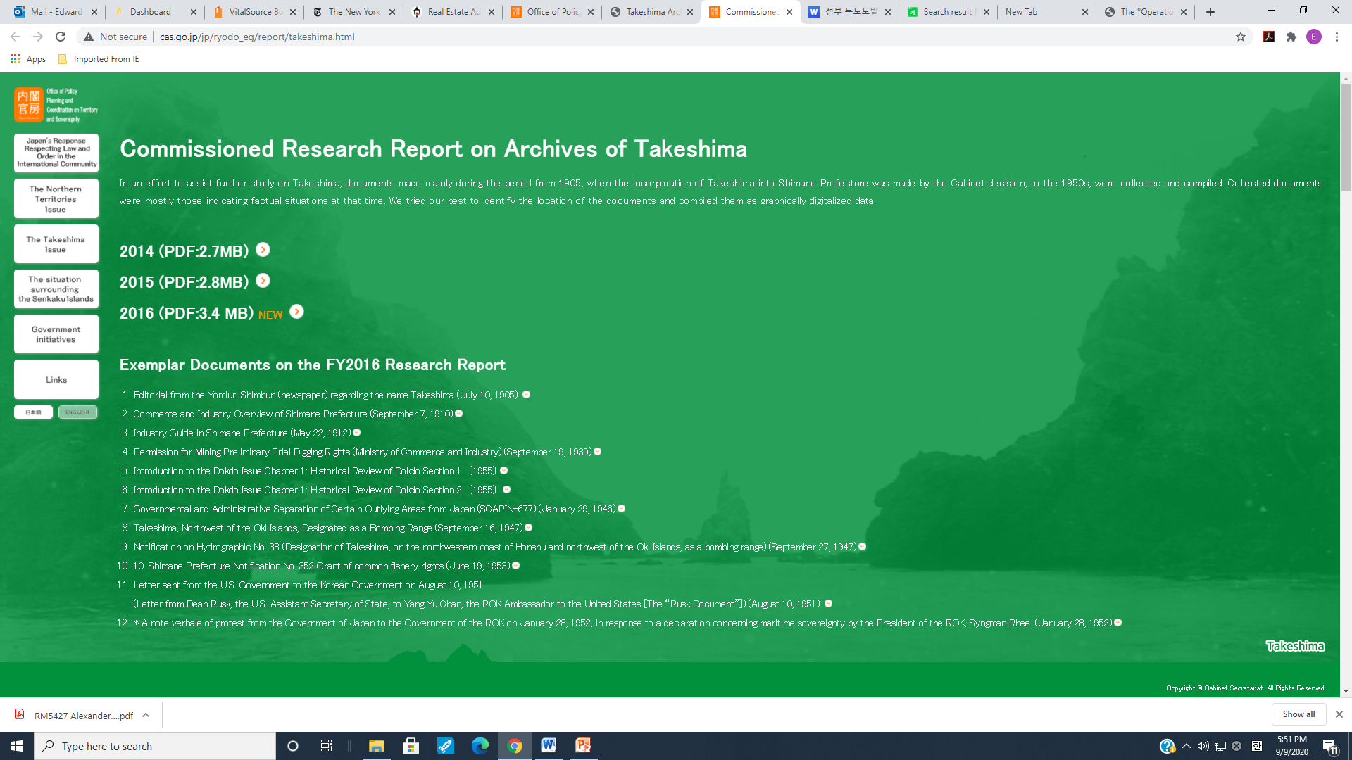

Slide 16
3. Longer-term Policy
Japan whitewashes Japan’s wartime history and brainwashes people into a misguided sense of nationalism and erroneous ideas about the Dokdo
Use textbook screening, repeated infusion of a fabricated territorial claim over the Dokdo fool the Japanese people into a belief that Korea illegally occupies the Dokdo.
Young Japanese are vulnerable to blind faith in Japanese nationalism
the historical truths about the fascist regime decided to invade neighbor countries and attack Pearl Harbor,
the brutality of their ancestors’ occupation of Asian nations,
the military regime forced thousands of innocent women into sexual slaves

Slide 17
VI. Conclusion
Abe definitely recognizes that his wrongful territorial claims over the Dokdo severely undermines cooperative international relations between Korea and Japan
Unfortunately, Abe is unlikely to change his mindset
However, both South Korea and Japan need to maintain an intense cooperation with the United States in order to cope with the rise of China and security threats from North Korea

Slide 18
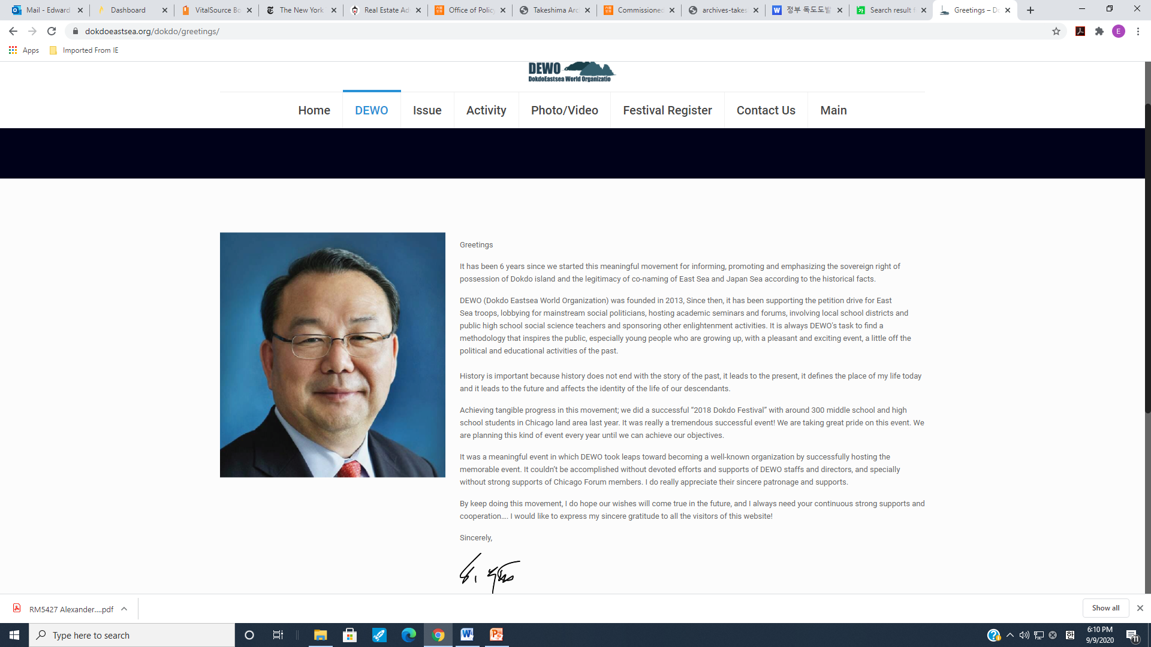
The devotion of Civil Society Group
Grassroots politics
People are working together to address a common problem
Alexis de Tocqueville considered such grassroots community action as the foundation of democracy in America

Slide 19
