Slide 1
East Sea: School Textbooks, Public Interest, and Educational Practice
Joseph P. Stoltman Department of Geography Western Michigan University, Kalamazoo, MI USA 49008

Slide 2
Highlights of the East Sea Naming issue in the U.S.
State of Virginia - February 6, 2014, the Virginia House passed the bill that required all Virginia textbooks to include the East Sea alongside the Sea of Japan
State of New York - August 6, 2019 The New York State Social Studies Framework does not specifically refer to the Sea of Japan or the East Sea; however, while teaching about this geographical location, school districts should be sensitive and responsive to the historical significance of both names. The NYSED recommends teachers refer to the body of water on the eastern boundary of Asia between Korea and Japan as both the East Sea and the Sea of Japan.

Slide 3
Geography Textbooks and Geographical Names
1793: First Geography Textbook Written and Published in the U.S. used Korean Sea in 1801 edition
Mid-1800s - Korean Sea no longer used after mid-1800s in U.S. Geography Texts
1929 – U.S. textbook publishers begin using the IHO adopted name as new books are printed using Sea of Japan
1934: Macmillian Published the final textbooks using Japan Sea rather than Sea of Japan.
1940: Sea of Japan name used in geography textbooks

Slide 4
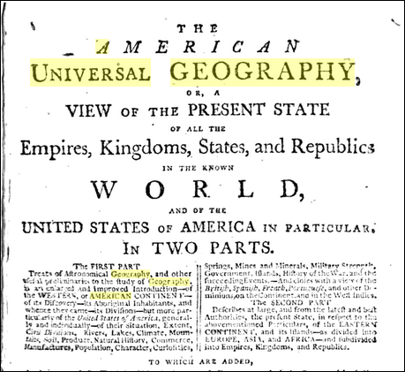
1801 Morse Geography: Korean Sea
Notes:
The American Universal Geography 1st edition1789; 2nd edition 1796; 3rd edition 1801; 4th edition in 1801-2; 5th edition in 1805; 6th edition 1812; Due to poorly constructed maps in the U.S. the New and Elegant Maps were updated for the Eastern Hemisphere (Vol 2). This is probably an 3rd edition map not changed; The name of the waterbody probably did not change from first to sixth printing in accordance with the atlas companion atlas Advertised with 19 maps in the book.
Starting with the 1805 edition, Morse acquired this atlas (originally published in 1804 to accompany the Philadelphia edition of Pinkerton's Geography) for his Geography. Maps without color bound with paper-covered quarter leather boards.
Source for information: https://www.davidrumsey.com/luna/servlet/detail/RUMSEY~8~1~31665~1150526:-Title-Page-to--A-new-and-elegant-g
https://books.google.co.kr/books?id=bz4wAAAAYAAJ&printsec=frontcover&dq=American+Universal+Geography+Google+Books&hl=ko&sa=X&ved=0ahUKEwiwleu4woTjAhWEad4KHTDHDqoQ6AEILzAB#v=onepage&q=American%20Universal%20Geography%20Google%20Books&f=false

Slide 5
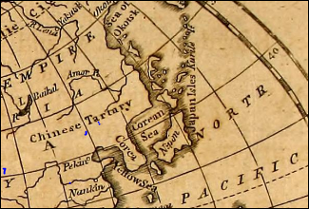
1801: Map from Geography Made Easy
Notes:
Source: Morse American Universal Geography 3rd edition 1801
https://archive.org/details/americanuniversa01inmors/page/n7

Slide 6
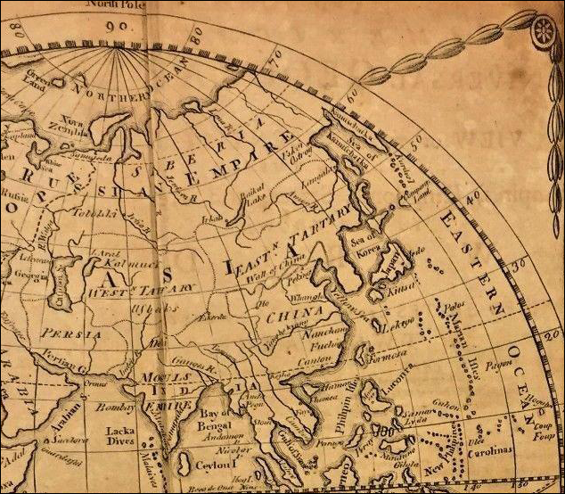
1805: Sea of Korea in Morse Textbooks
Notes:
Source: Morse American Universal Geography 4th edition 1805
https://books.google.co.kr/books?id=t4E9AAAAYAAJ&printsec=frontcover&hl=ko&source=gbs_ge_summary_r&cad=0#v=onepage&q&f=false
Map is probably from the New and Elegant General Atlas
Morse Universal Geography labels water body as Sea of Korea
Starting with the 1805 edition, Morse acquired this atlas (originally published in 1804 to accompany the Philadelphia edition of Pinkerton's Geography) for his Geography. Maps without color bound with paper-covered quarter leather boards.

Slide 7
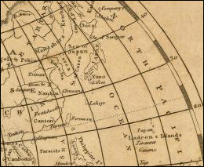
1810: Sea of Japan Used in the Morse Textbooks
Notes:
Source: New and Elegant General Atlas 1805 5th edition using the New and Elegant General Atlas
https://www.davidrumsey.com/luna/servlet/view/search?q=pub_list_no%3d%220028.000%22&qvq=lc:RUMSEY~8~1&mi=0
Morse Geography Made Easy 6 th edition in 1812 used this same map
https://books.google.co.kr/books?id=Xz8NAQAAIAAJ&printsec=frontcover&hl=ko&source=gbs_ge_summary_r&cad=0#v=onepage&q&f=false

Slide 8
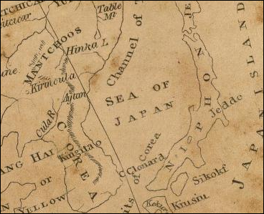
1812: Maps used in Morse Text from the New and Elegant General Atlas
Notes:
Source: The New and Elegant General Atlas (Arrowsmith and Lewis, 1812)
https://www.davidrumsey.com/luna/servlet/detail/RUMSEY~8~1~31686~1150481:Asia-?qvq=q:pub_list_no%3D%220028.000%22;lc:RUMSEY~8~1&mi=22&trs=66

Slide 9
1924: Barrows and Parker, U.S.
Notes:
{Barrows, 1924 #458}
Barrows, H. H., & Parker, E. P. (1924). Geography: Journeys in Distant Lands. New York Silver, Burdett and Company.

Slide 10
No Northeast Asian water bodies were named in Barrows and Parker, 1924

Slide 11
1932: Living Geography, Huntington,Benson, and McMurry, U.S.
Notes:
{Huntington, 1932 #457}
Huntington, E., Henson, C. B., & McMury, F. M. (1932). Living Geography: Book One How Countries Differ. New York: The MacMillan Company.
Uses Japan Sea

Slide 12
1934: Japan Sea is last used and Sea of Japan becomes widely used geographical name, Living Geography, Huntington, Benson, and McMurry, U.S.

Slide 13
Notes:
{Dawe, 1910 circa #455}
Dawe, C. W. (1910 circa). The Higher School Geography. London: The Educational Supply Association Limited.

Slide 14
Circa 1910: Sea of Japan in Higher School Geography by C.S. Dawe, United Kingdom
Notes:
Circa 1910: 1905 Population is given for London, Austro Hungarian Empire still on map of Europe p 66; Germany on map; Turkey on map, but in Southeast Europe with boundaries of Ottoman Empire; definitely pre WWI

Slide 15
Notes:
{Stamp, 1931 #456}
Stamp, L. D. (1931). New Secondary School Geography. Bombay: Orient Longmans Ltd.

Slide 16
1931: Sea of Japan in New Secondary School Geography by L. Dudley Stamp, United Kingdom
Notes:
{Stamp, 1931 #456}

Slide 17
Dual Naming Sea of Japan (East Sea) in U.S. Geography Textbooks

Slide 18
2007: South and East Asia and the Pacific, Holt, Rhinehart and Winston, U.S.

Slide 19
2008: Glencoe, U.S.

Slide 20
2008: World Geography and Cultures, Glencoe, U.S.

Slide 21
Title of Textbook | Publisher | Publication Date | Number of Relevant Maps | Sea of Japan (East Sea ) | Sea of Japan | No Name*
South and East Asia and the Pacific | Holt | 2007 | 19 | 12 | 1 | 6
Exploring Our World: People Places and Culture (World Geography) | McGraw Hill - Glencoe | 2008 2nd printing | 6 | 6 | 0 | 0
World Geography and Cultures | McGraw Hill - Glencoe | 2008 6th Print | 17 | 15 | 0 | 2
Holt McDougal World Geography | Holt Rinehart and Winston | 2009 | 23 | 0 | 21 | 2

Slide 22
Exploring Our World: People Places and Culture Eastern Hemisphere | McGraw Hill - Glencoe | 2010 2nd Printing | 11 | 10 | 0 | 1
Geography Alive: Regions and People | Teachers’ Curriculum Institute | 2011 2nd printing | 11 | 7 | 0 | 4
World Geography and Cultures | Glencoe McGraw Hill | 2012 | 14 | 14 | 0 | 0
World Cultures and Geography | Cengage | 2017 | 14 | 14 | 0 | 0
Global Geography | Houghton Mifflin Harcourt | 2019 | 13 | 13 | 0 | 0
Geography Alive: Regions and People | Teachers’ Curriculum Institute | 2019 | 12 | 12 | 0 | 0

Slide 23
Educational Practice: Engaging Students with the Dual Naming Context

Slide 24
Search Engines that Display Maps

Slide 25
Google Search Engine: Small Scale (9/5/20)

Slide 26
Google Search Engine: Larger Scale

Slide 27
Google Search Engine: Dokdo (special interest)

Slide 28
Educational Practice = Classroom Engagement
The dual naming Sea of Japan (East Sea) is on the maps in most school geography textbooks
Map usage is often from the World Wide Web
Engaging students with the dual name is now the challenge

Slide 29
New Challenges in East Sea Naming Issue
Easily accessible East Sea materials; Web based. Narratives in books is limited by pages.
Series of short lessons on the East Sea naming issue from a disciplinary and interdisciplinary perspective
Teacher professional development activities; conference sessions, workshops, and webinars.

Slide 30
Public Interest in the East Sea Toponym
Public interest in an issue can reduce confusion.
Public interest often leads to a solution to an issue or problem.
Public interest extends beyond public policy and is a powerful incentive to bring about change.
Public interest in an issue must develop a dynamic and ongoing process. It must be constantly reassessed, revisited and revised (Birkland 2011)

Slide 31
Voluntary Agency Network of Korea
Notes:
VANK (Voluntary Agency Network of Korea) is a cyber diplomacy organization of 120,000 Korean and international members united under the purpose of properly introducing Korea to the world and promoting cultural exchange through international friendships.
VANK was founded in 1999 when one young man began exchanging emails with a pen pal and became shocked to find that his international friends either knew very little about Korea or possessed incorrect information about Korea. This one young man, the founder, began to imagine a future where Koreans could establish sincere relationships with international friends from all over the world. Through these relationships, the global community could gain a holistic and accurate understanding of Korea.
http://usa.prkorea.com/about-vank/

Slide 32
Korean Boy Bands and Naming Issue
Notes:
https://www.scmp.com/news/asia/east-asia/article/2183018/tokyo-discuss-sea-japans-name-seoul-just-dont-call-it-east-sea

Slide 33
The use of geographic names is interwoven into the fabric of society—language, music, tradition, and long-standing records on maps and documents.
Geographical naming is a process that requires sensitivity to public interest, accomplished education and cooperation between government and the citizens they represent

Slide 34
Public Interest Buttons
Culture and Society
Education
Foreign Affairs and National Security

Slide 35
Thank you

